Slide 1
5 Reasons why Spark is in demand !

Slide 2
Agenda
At the end of this webinar you will be able to know about:
Reason #1 : Low Latency
Reason #2 : Streaming Support
Reason #3 : Machine Learning and Graph
Reason #4 : Data Frame API introduction
Reason #5 : Spark integration with hadoop

Slide 3
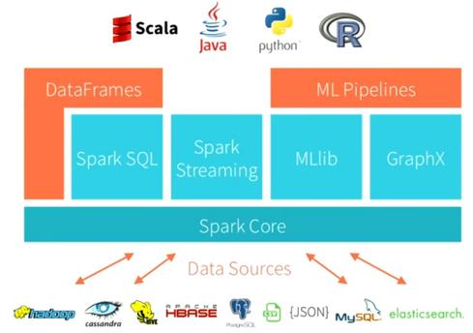
Spark Architecure
Utility for continues ingestion of data
Graph programming
Spark interface
For RDBMS lovers
Machine Learning
Library

Slide 4
Low Latency

Slide 5

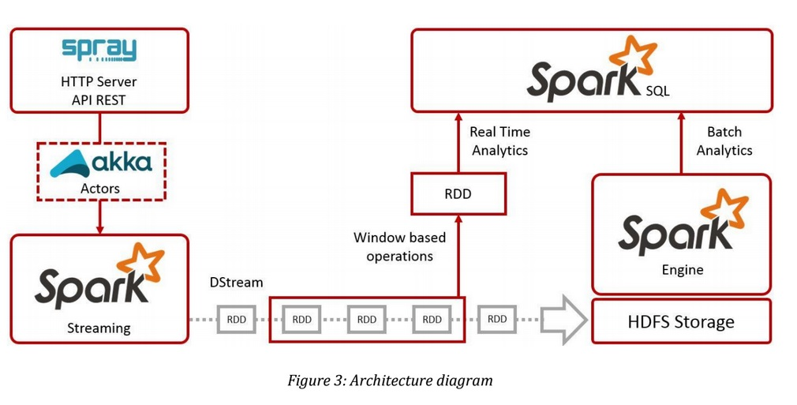
Sparks Cuts Down Read/Write I/O To Disk
Spark tries to keep things in-memory of its distributed workers, allowing for significantly faster/lower-latency computations, whereas MapReduce keeps shuffling things in and out of disk.
Spark is good for data that fits in memory and off memory

Slide 6
How Fast A System Can Sort 100 TB Of Data
The previous world record was 72 minutes, set by Yahoo using a Hadoop MapReduce cluster of 2100 nodes
Using Spark on 206 EC2 nodes, spark completed the benchmark in 23 minutes.
Spark sorted the same data 3X faster using 10X fewer machines
All the sorting took place on disk (HDFS), without using Spark’s in-memory cache.

Slide 7

Sparks Benchmark
2014, 4.27 TB/min
100 TB in 1,406 seconds
207 Amazon EC2 i2.8xlarge nodes x
(32 vCores - 2.5Ghz Intel Xeon E5-2670 v2, 244GB memory, 8x800 GB SSD)
Reynold Xin, Parviz Deyhim, Xiangrui Meng,
Ali Ghodsi, Matei Zaharia
Courtesy : sortbenchmark.org/

Slide 8
Streaming Support

Slide 9
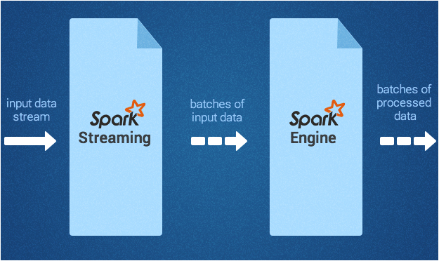
Event processing
Used for processing the real-time streaming data.
It uses the DStream : a series of RDDs, to process the real-time data
support streaming analytics reasonably well.
The Spark Streaming API closely matches that of the Spark Core

Slide 10
Machine Learning and graph
implementation with DAG

Slide 11
Machine Learning
MLlib,a machine learning library
classification
regression
clustering
collaborative filtering
and so on
Some of these algorithms also work with streaming data, such as linear regression using ordinary least squares or k-means clustering

Slide 12
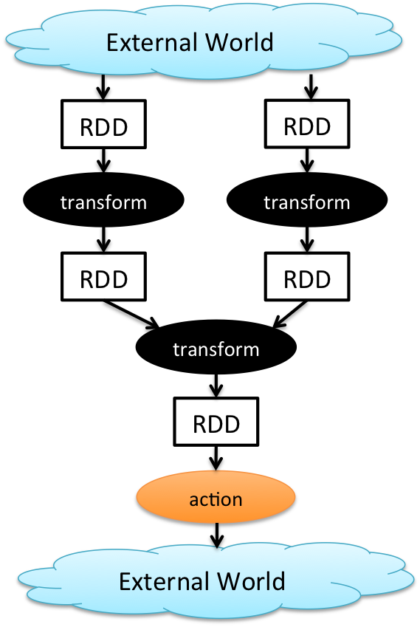
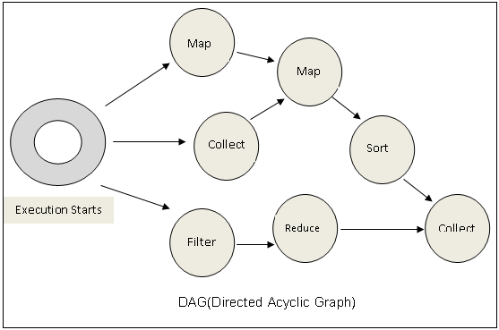
Cyclic Data Flows
All jobs in spark comprise a series of operators and run on a set of data.
All the operators in a job are used to construct a DAG (Directed Acyclic Graph).
The DAG is optimized by rearranging and combining operators where possible.

Slide 13
GraphX
Component for graphs and graph-parallel computation
Extends the Spark RDD by introducing a new Graph abstraction
Graph Algorithms
PageRank
Connected Components
Triangle Counting

Slide 14
Support for Data Frames

Slide 15
DataFrame
As spark continues to grow, it wants to enable wider audiences beyond “big data” engineers to leverage the power of distributed processing.
Inspired by data frames in r and python (pandas)
Dataframes API is designed to make big data processing on tabular data easier
Dataframe is a distributed collection of data organized into named columns.
Provides operations to filter, group, or compute aggregates, and can be used with spark sql.
Can be constructed from structured data files, existing rdds, tables in hive, or external databases.
Notes:
You can show hands on with data frames like
Load data into Spark DataFrames
Explore data with Spark SQL
Here is a reference for hands on : https://www.mapr.com/blog/using-apache-spark-dataframes-processing-tabular-data#.VdxJofmqqko

Slide 16
DataFrame features
Ability to scale from KBs to PBs
Support for a wide array of data formats and storage systems
State-of-the-art optimization and code generation through the spark SQL catalyst optimizer
Seamless integration with all big data tooling and infrastructure via spark
Apis for python, java, scala, and R (in development via sparkr)

Slide 17
Spark can use HDFS
Spark can use YARN

Slide 18
Spark Execution Platforms
Spark can leverage the resource negotiator of Hadoop framework i.e. YARN
Spark workloads can make use of Symphony scheduling policies and execute via YARN
Spark execution modes
Standalone
Mesos
HDFS

Slide 19
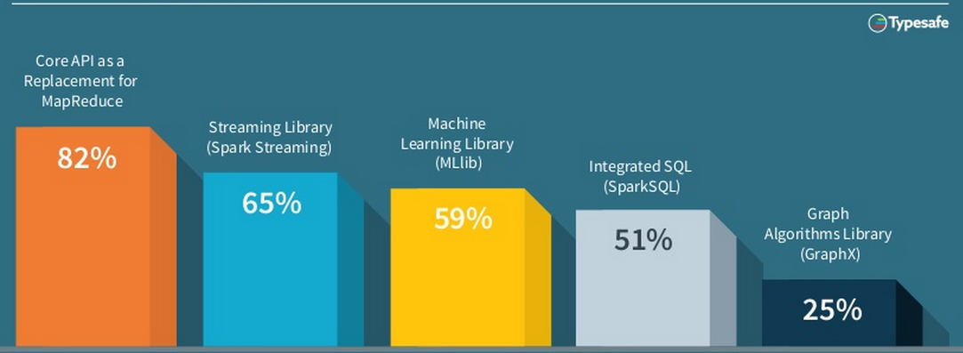
Spark Features/Modules In Demand
Source: Typesafe

Slide 20

New Features In 2015
Data Frames →
Similar API to data frames in R and Pandas
Automatically optimised via Spark SQL
Released in Spark 1.3
SparkR →
Released in Spark 1.4
Exposes DataFrames, RDD’s & ML library in R
Machine Learning Pipelines →
High Level API
Featurization
Evaluation
Model Tuning
External Data Sources →
Platform API to plug Data-Sources into Spark
Pushes logic into sources
Source: Databrix
Notes:
http://www.information-management.com/gallery/Big-Data-Hadoop-2015-Predictions-Forrester-10026357-1.html
https://www.forrester.com/Predictions+2015+Hadoop+Will+Become+A+Cornerstone+Of+Your+Business+Technology+Agenda/fulltext/-/E-RES117705

Slide 21
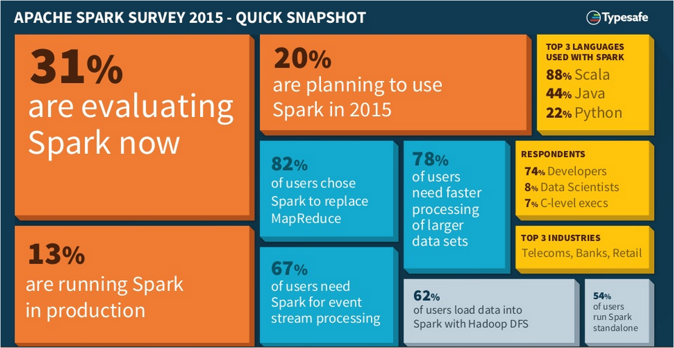
Spark overview

